Slide 1
Advanced Angular
Routing and Navigation
Lecture 8
By James(Jin) Wang
10/05/2019

Slide 2
Outline
Configuring Routes
Implementing single page applications (SPAs)
Working with route and query parameters
Programmatic navigation

Slide 3
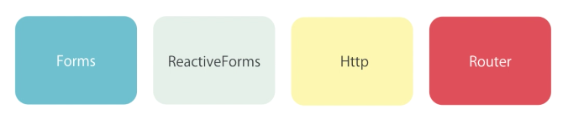
Configuring Routes
  Modules:

Slide 4
Configuring Routes
  Steps:
  Configure the routes
  Add a router outlet
  Add links

Slide 5
Configuring Routes
  Configure the routes:
  add:
  RouterModule.forRoot([
  {path: '', component: HomeComponent},
  {path: 'followers', component: GithubFollowersComponent},
  {path: followers/:id', component: GithubProfileComponent},
  {path: 'posts', component: PostsComponent},
  {path: '**', component: NotFoundComponent}
  ])

Slide 6
Configuring Routes
  RouterOutlet:
  add:
  <router-outlet></router-outlet>

Slide 7
Configuring Routes
  RouterLink:
  add: (navbar.component.html)
  <li class="active"><a routerLink="/followers">Followers</a></li>
  <li><a routerLink="/posts">Posts</a></li>
  add: (github-followers.component.html)
  <h4 class="media-heading">
  <a [routerLink]="['/followers', follower.id]">{{ follower.login }}</a>
  </h4>

Slide 8

Configuring Routes
  RouterLink:
  Simple route
  route parameters

Slide 9
Configuring Routes
  RouterLinkActive:
  add: (navbar.component.html)
  <li routerLinkActive="active current"><a routerLink="/followers">Followers</a></li>
  <li routerLinkActive="active current"><a routerLink="/posts">Posts</a></li>

Slide 10
Configuring Routes
  Accessing Route Parameters:
  add: (github-profile.component.ts)
  constructor(private route: ActivatedRoute) { }
  ngOnInit() {
  this.route.paramMap
  .subscribe(params => {
  let id = +params.get('id');
  console.log(id);
  });
  }

Slide 11
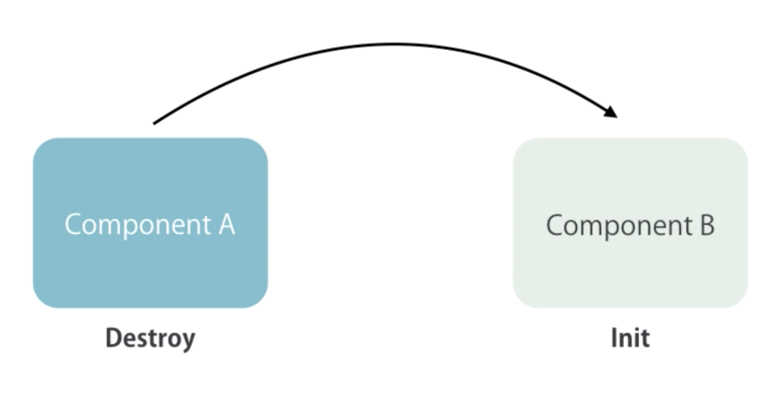
Configuring Routes
  Why Route Params are Observables:
  Navigation

Slide 12
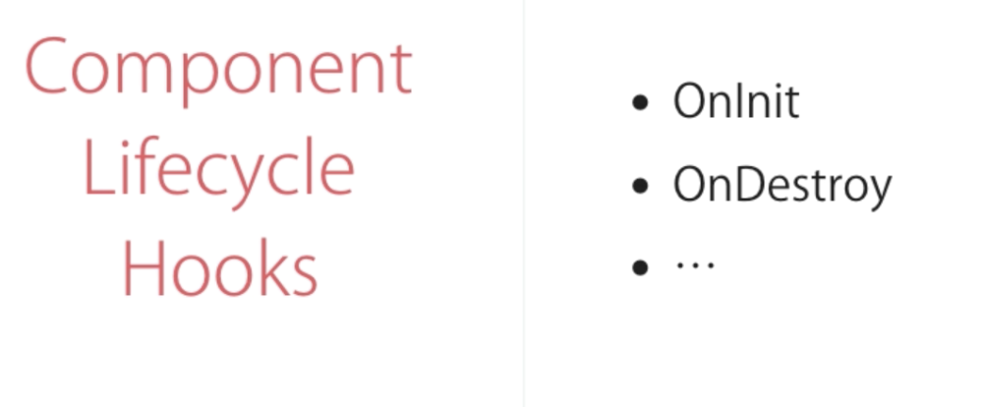
Configuring Routes
  Component Lifecycle Hooks

Slide 13
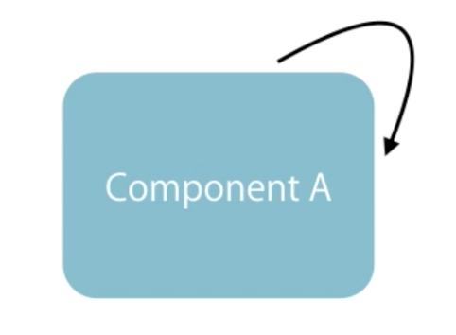
Configuring Routes
  Navigation

Slide 14
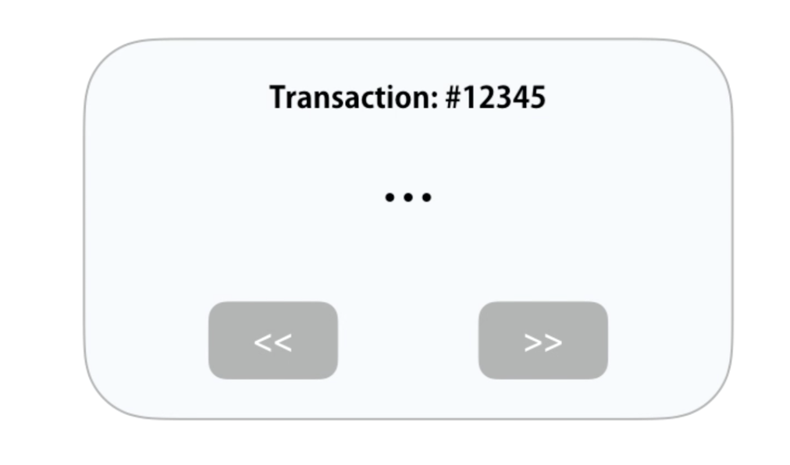
Configuring Routes
  Real-world Example

Slide 15
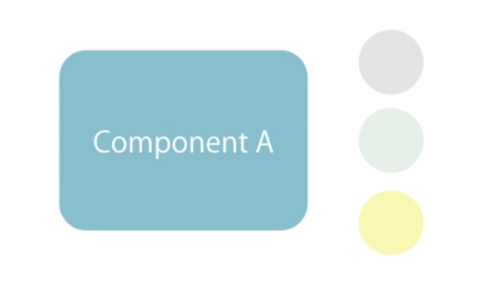
Configuring Routes
  Route Parameters

Slide 16

Configuring Routes
  Observables

Slide 17
Configuring Routes
  Observables
  add: (github-profile.component.html)
  <button [routerLink]="['/followers', 1234]" class="btn btn-primary">Next</button>
  add: (github-profile.component.ts)
  ngOnInit() {
  console.log("Github profile, oninit!");
  }

Slide 18
Configuring Routes
  snapshot
  add: (github-profile.component.ts)
  ngOnInit() {
  let id = this.route.snapshot.paramMap.get('id');
  console.log(id);
  }

Slide 19
Configuring Routes
  Routes with Multiple Parameters
  add: (app.module.ts)
  {path: 'followers/:id/:username', component: GithubProfileComponent},
  add: (github-followers.component.html)
  <a [routerLink]="['/followers', follower.id, follower.login]">{{ follower.login }}</a>

Slide 20
Configuring Routes
  Query Parameters
  add: (navbar.component.html)
  <a routerLink="/followers" [queryParams]="{ page: 1, order: 'newest'}">Followers</a>
  add: (github-followers.component.ts)
  private route: ActivatedRoute,

Slide 21
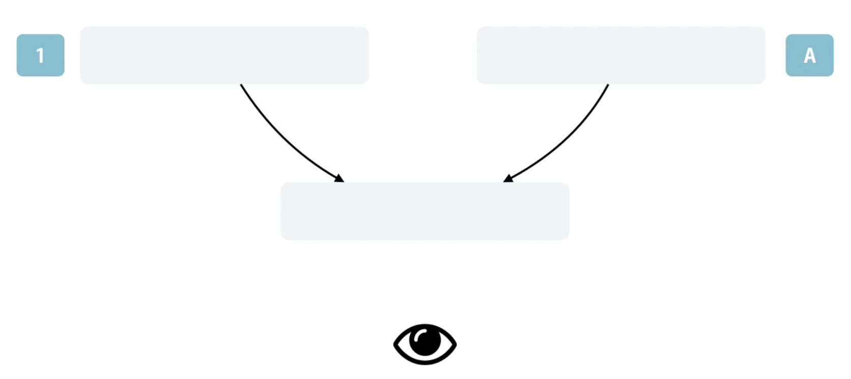
Configuring Routes
  Subscribe to Multiple Observables
  add: (github-followers.component.ts)
  import { Observable } from 'rxjs/Observable';
  import 'rxjs/add/observable/combineLatest';

Slide 22
Configuring Routes
  Subscribe to Multiple Observables
  add: (github-followers.component.ts)
  Observable.combineLatest([
  this.route.paramMap,
  this.route.queryParamMap
  ])
  .subscribe(combined => {
  let id = combined[0].get('id');
  let page = combined[1].get('page');
  // this.service.getAll({ id: id, page: page });
  });

Slide 23
Configuring Routes
  SwitchMap Operator
  remove: (data.service.ts)
  getAll() {
  return this.http.get(this.url);
  // .map(response => response.json())
  // .catch(this.handleError);
  }

Slide 24
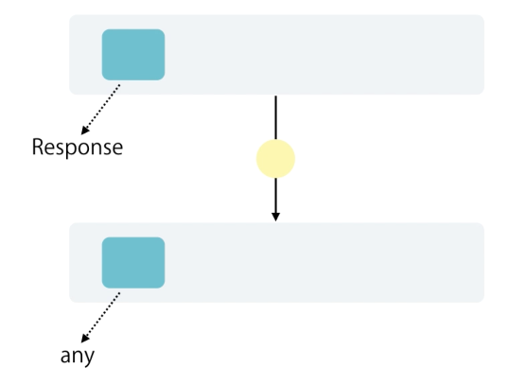
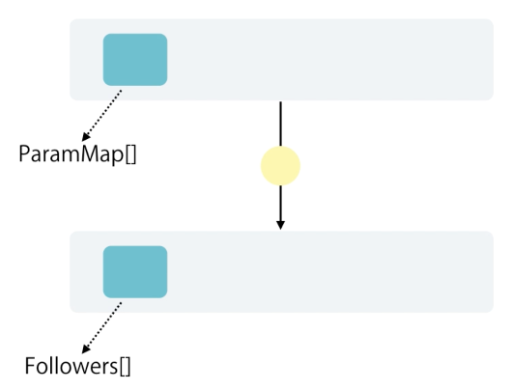
Configuring Routes
  SwitchMap Operator

Slide 25

Configuring Routes
  SwitchMap Operator
  add: (github-followers.component.ts)
  import 'rxjs/add/operator/map';
  import 'rxjs/add/operator/switchMap’;

Slide 26
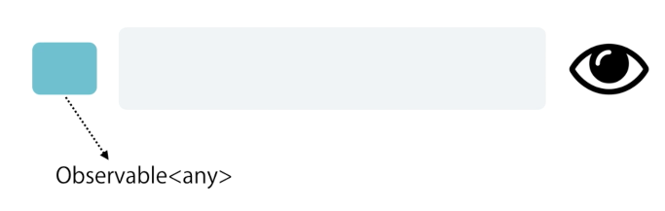
Configuring Routes
  add: (github-followers.component.ts)
  .switchMap(combined => {
  let id = combined[0].get('id');
  let page = combined[1].get('page');
  return this.service.getAll();
  })
  .subscribe(followers => this.followers = followers);

Slide 27
Configuring Routes
  Programmatic Navigation
  add: (github-profile.component.ts)
  submit() {
  this.router.navigate(['/followers'], {
  queryParams: { page: 1, order: 'newest'}
  })
  }

Slide 28
Summary

